Slide 1
What is MAPW’s role in disrupting and opposing AUKUS? Richard Tanter
17 August 2022
rtanter@nautilus.org https://nautilus.org/network/associates/richard-tanter/publications/
https://nautilus.org/network/associates/richard-tanter/talks/

Slide 2
Outline
Introduction
The bad joke: Marles on Britain
The good joke: the Chinese Note Verbale to the IAEA on AUKUS’
MAPW at this point in our history
What is AUKUS?
The submarines
Beyond the submarines?
AUKUS Plus
Frame for opposing China and preparing for war
Where to start? No war, real security, and MAPW’s skill set and model
Build resources – and what is already present
Domestic links
International links – with Australia’s ‘allies’, and above all with China
Public education and peace research: a proposal

Slide 3
Australia’s renewed Anglosphere longings
Richard Marles, Minister for Defence in the ALP government (The Age, 1 September 2022):
“We see the relationship with Britain as being very central to our national interest and our world view.
“We will have an intense and ongoing agenda with Britain.
“Britain is now oldest relationship.”

Slide 4
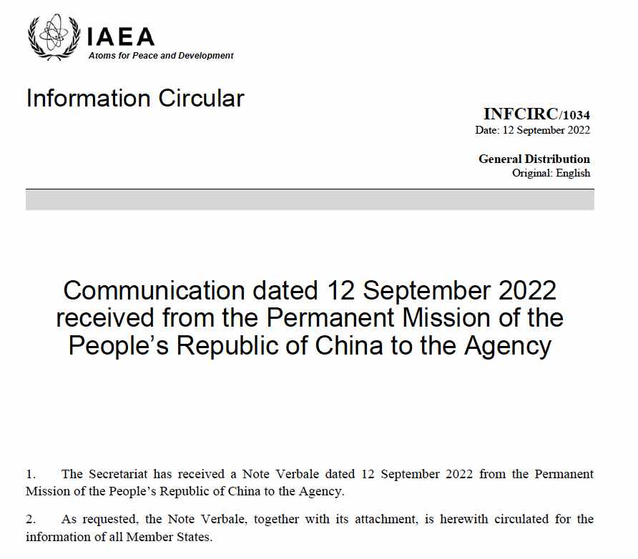
China’s Working Paper on the Nuclear Submarine Cooperation under AUKUS, Vienna, 12 September 2022
Critique of two documents circulated to the IAEA in August and September by the AUKUS states.
China maintains those documents are “an obvious cover-up effort by the three countries to conceal the true nature of their trilateral nuclear submarine cooperation, which is nothing but an act of nuclear proliferation.”
Notes that “a wide range of member states have expressed their support for the concerns voiced in the10th NPT Review Conference working paper (NPT/CONF.2020/WP,67) regarding cooperation among the three countries.
“In this context, China, for its part, wishes to solemnly articulate its formal position on the sinister and illegal moves of the three countries and the flawed and self-serving arguments being advanced to justify them as well as the inappropriateness of the Director-General’s report.”
https://www.iaea.org/sites/default/files/publications/documents/infcircs/2022/infcirc1034.pdf

Slide 5
The Chinese accusations against the AUKUS states
‘Firstly, the three countries have done its utmost to disguise, under the pretext of the “naval nuclear propulsion” , the “original sin” that their trilateral cooperation involves the transfer of nuclear weapon material from Nuclear-Weapons States to a NPT Non-Nuclear-Weapon-State...
‘Secondly, the three countries have deliberately confused legitimate military activities within a country’s sovereignty with acts of nuclear proliferation...
‘Thirdly, the three countries have misled the international community claiming that “nuclear material would be sealed in the reactors” and ‘‘cannot be directly used in nuclear weapons”...
‘Fourthly, the three countries, especially Australia, have failed their reporting obligations required under their CSA and relevant protocols...
‘Fifthly, the three countries’ claim that they “are engaging the IAEA regularly with respect to the development of a suitable verification arrangement” is totally untenable...
‘Sixthly, the three countries have undermined the non-proliferation functions and integrity of the Agency by taking hostage of the Secretariat to engage in activities prohibited by the statute...
‘In addition, the three countries have consistently refused to report to the Agency on the substantive progress of nuclear submarine cooperation on the grounds that “no cooperation programme has been established"...’

Slide 6
The Conclusion to the Chinese Note Verbale
‘China maintains that the nuclear submarine cooperation under AUKUS violates the NPT, the CSA and the AP. It is a sheer act of nuclear proliferation with enormous negative impacts and the three countries should thus stop this cooperation, without delay.
‘If the three countries are bent in their own way by pushing ahead their cooperation, all Member States of the Agency have the responsibility and obligation to tell them what to do by working out, through the intergovernmental consultation process, an agreed formula to address this issue, and submit a report on recommendations to the Agency’s Board of Governors and the General Conference accordingly.
‘Pending the consensus among the member states, the three countries should refrain from pushing ahead their nuclear submarine cooperation programmes, while the Agency’s Secretariat, for its part, should not proceed further in its engagement, with the three countries on any safeguard arrangement relating to the three countries’ nuclear submarine cooperation under AUKUS in the absence of due mandate from member States.
‘China urges the three countries to immediately stop relevant acts of nuclear proliferation, and calls on the Director General to continue to make impartial and objective reports on the issue of nuclear submarine cooperation under AUKUS.
‘At the same time, China also calls on all member states of the Agency to continue to participate in the discussions on the subject under the agenda item proposed by China, as well as the Director General’s report, at this Board meeting and the upcoming General Conference.’

Slide 7
What China has done with the legal attack on the AUKUS states?
Directly challenged the AUKUS states in the principal nuclear legal arena
Plausibly claimed the AUKUS submarine deals amounts a potent violation and subversion of the IAEA’s non-proliferation objectives and obligations.
Successfully invoked US-defined standards of the “rules-based international order” against the US regarding the NPT.
Widened the critique of the AUKUS submarines deal to a formally global audience
Broadened the grounds of critique of the AUKUS AUKUS submarines deal to failures of the NPT and IAEA treaty obligations by the AUKUS states
Pointed to US pressuring of the IAEA Secretariat ”held hostage”, and criticized the ”inappropriateness” of the IAEA Director-General’s reporting.
Called for formation of an anti-AUKUS coalition of NPT member states

Slide 8
MAPW at this point in our history - starting points
MAPW at this point in our history
2. Where to start? No war, real security, and MAPW’s skill set and model

Slide 9
3. What is AUKUS?
3. What is AUKUS?
The submarines
Beyond the submarines?
AUKUS Plus
Frame for opposing China and preparing for war

Slide 10
Two starting points – resources and domestic links
Examples of what (and who) is already present and underway (somewhat randomly and with apologies for omissions
the point is not what or who is missing – a long list in both cases – but how people can be joined up and in public education and peace research (see below)
Some organisations | Some people
ICAN and nuclear specialists | Michelle Fahy
IPAN | Kellie Tranter / FOIA
AWPR | Monique Cormier / Anna Hood on law
State Capture project / accountability | Felicity Ruby and Scott Ludlam
NFIP | Emma Shortis (alliance)
AWM campaign | Brian Martin (peace movement thinking)
Frontier Wars | Nic Maclellan / NFIP
Pearls & Irritations writers on defence

Slide 11
International links – with Australia’s ‘allies’, and above all with China
Decline of international links in the peace movement – and potential benefits.
There will always be potential points of cooperation, common ground even amidst conflict and suspicion – importance of discovering shared concerns and interests
Follow the pattern of Australian government alliances in the broadest sense
Strategic partnerships, enhanced defence cooperation, mutual logistics and basing arrangements
There will always be potential points of cooperation, common ground even amidst conflict and suspicion
US
UK (aka Disuniting Kingdom)
Japan
France (and their colonial possessions in the neighbourhood)
India
Japan
Singapore (Kishore Mahbubani on AUKUS)
Vietnam

Slide 12
And above all, links with China
Very difficult at the best of times, and now harder than any time since 1973.
Effects of Chinese government climate, US (and “The Free Press”) public opinion restructuring, and Australian government ‘foreign influence’ legislation
First step is to find people to talk to; to find common ground, however limited, and to clarify actual as opposed to purported or imagined difference
From a basis of respectful listening, always acknowledge difference and disagreement, on the basis of commitment to impartial application of shared standards to all parties
to allow the possibility of Australian civil society contribution to and pressure for reform of Australian policy
A few starting points for interlocutors re security – there are known Chinese specialists on all
arms control and nuclear disarmament specialists
critique of foreign military bases and armed intervention
support for UN and international law
climate, energy and environmental science and policy
infectious diseases
Global inequality and injustice
Shared settler colonial history, policy and ideologies

Slide 13
How to proceed on China
Accept that this will be slow and bumpy – but vastly better than the alternative
How those Chinese contacts are to be established, fruitful discussions achieved, inevitable and sometimes serious bumps handled, and most importantly relationships maintained is obviously not straightforward.
But some of it should involve bringing people to Australia for carefully organised discussions, Chinese government connections or not
Public education and peace research: a proposal
We need to commit, through our various organizational connections and personal roles, to public education on the basis of authoritative, evidence-based, and accessible educational material
Key issues of controversy and public importance should be prioritized
Careful thought should be given to building a space for open and respectful discussion of the difficult elements and policy of peace and security

